Slide 1
Bakir Baxışov - 6224e
Verilənlərin strukturu və alqoritmlər-Quluzadə Dilarə
Azərbaycan Texniki Universiteti
İTT
İnformasiya Texnologiyaları
AI Chatbot with Tree – Use Tree and Hash Maps to store keywords and respond intelligently.

Slide 2

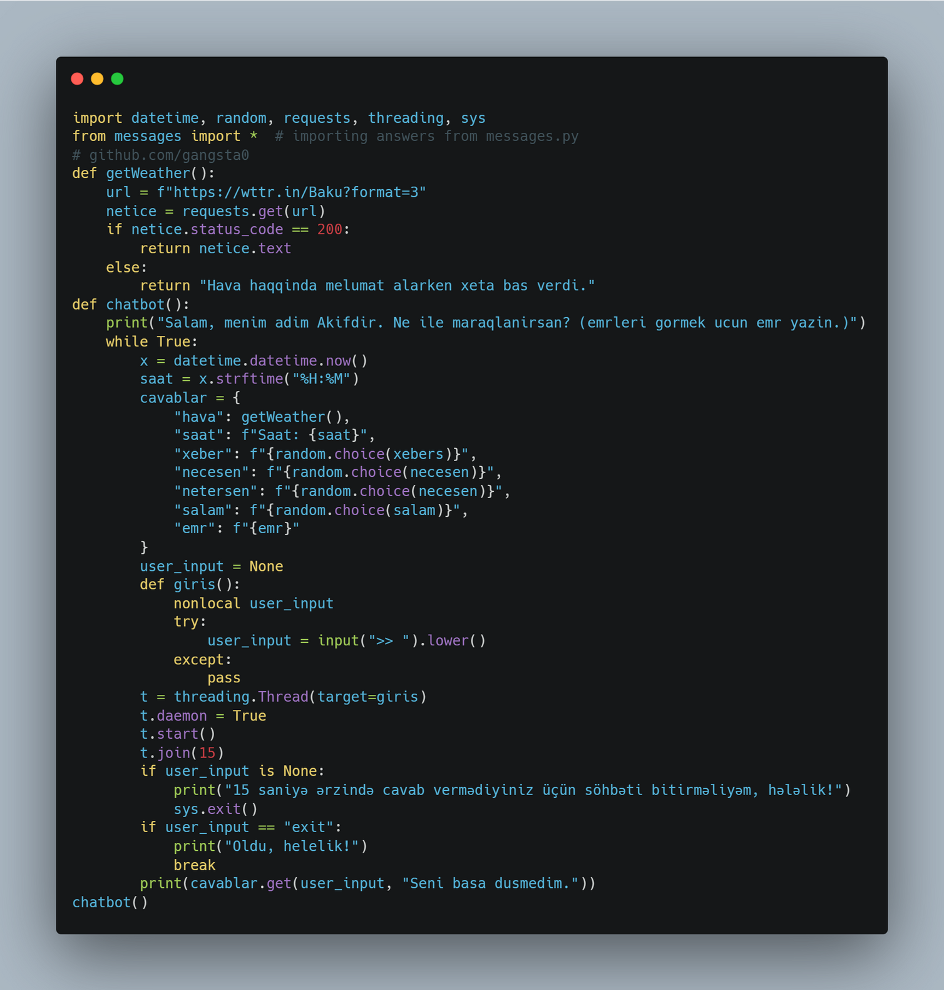
main.py

Slide 3
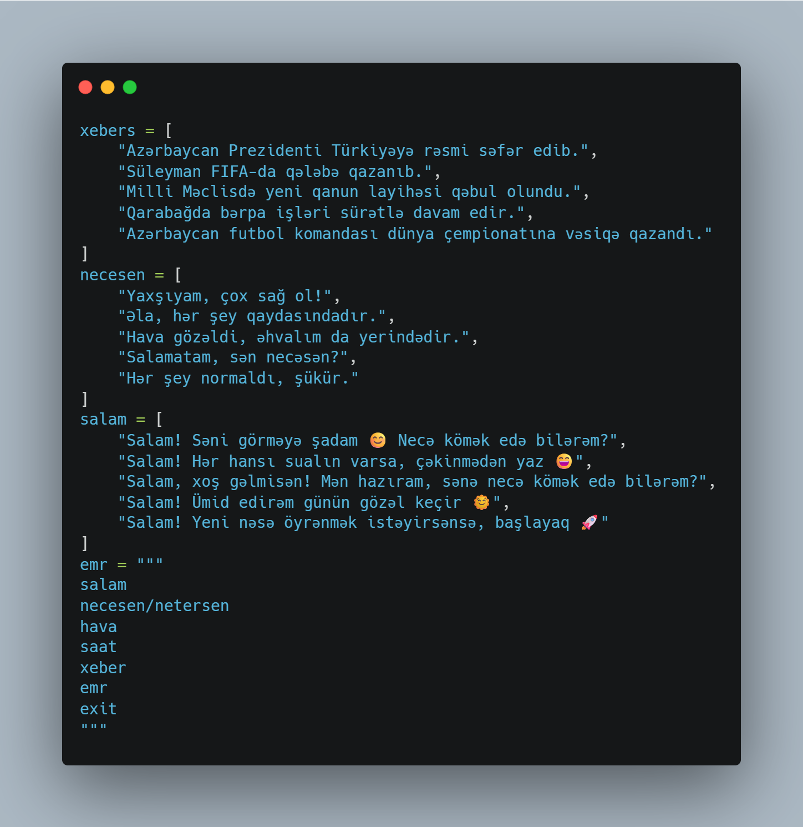
messages.py

Slide 4

Let explain codes.
In this project I used 2 script file. Differentiating the main codes and texts make codes more readable.
main.py for codes that run the program.
messages.py for chatbot answer messages.

Slide 5
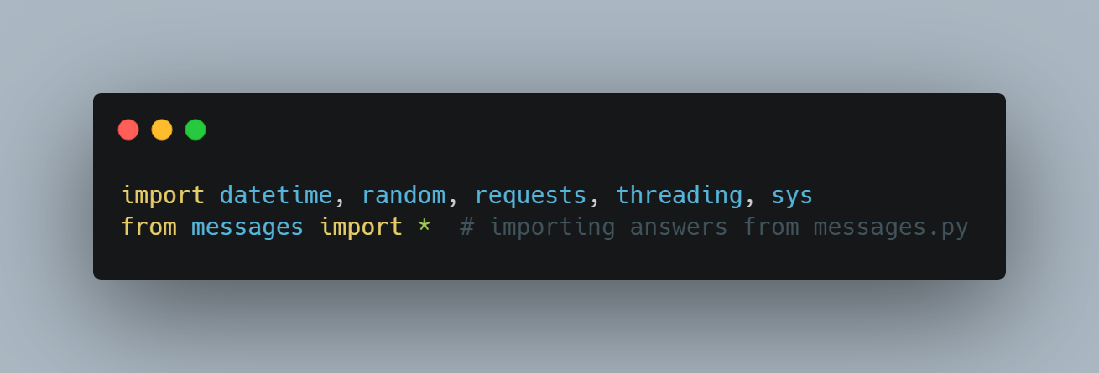
Imports
For this project we have to import datetime, random, requests, threading and sys. These are essential for some functions. And for answer messages we add messages.py. * means that import everything from messages.py

Slide 6


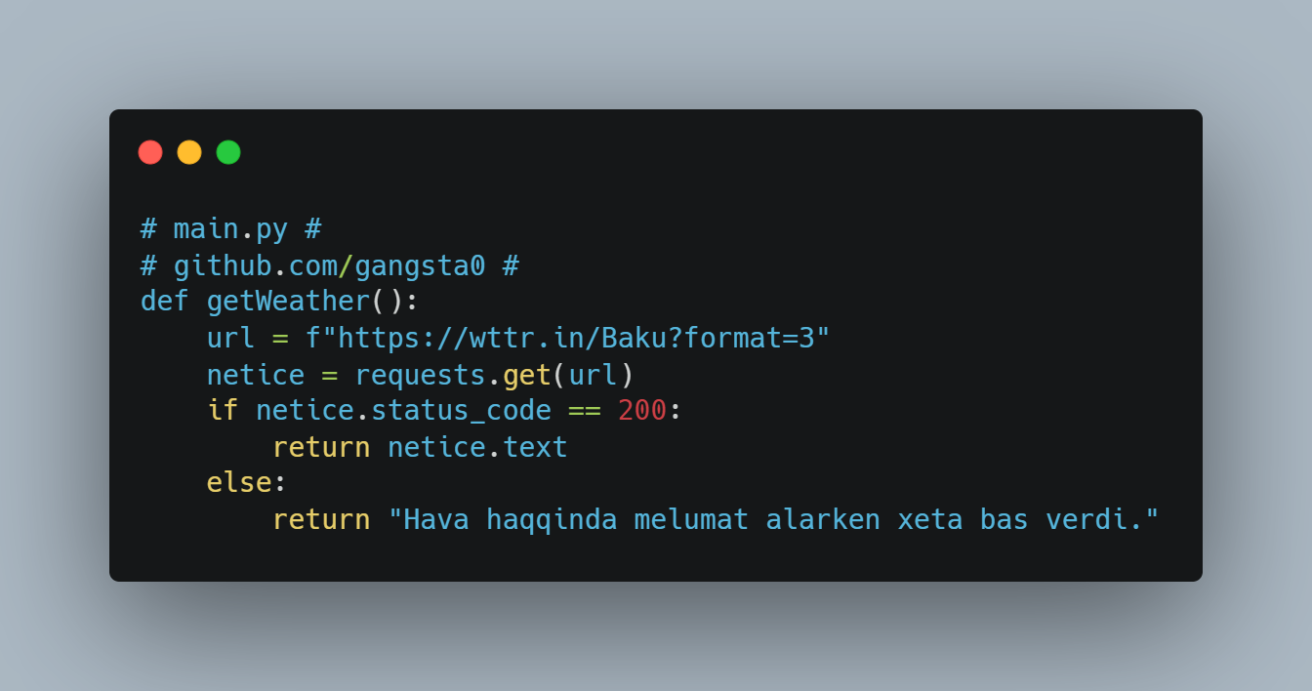
Weather Function
There is a function to get weather information. This function working with requests module. There is a website for getting weather information without any API. Requests module send a request to that site. If status code is 200, we can get weather information. If status code is not 200, there is a problem so we can’t get any information. That is the working principle of requests module. If status code is 200, getWeather function return weather information.

Slide 7
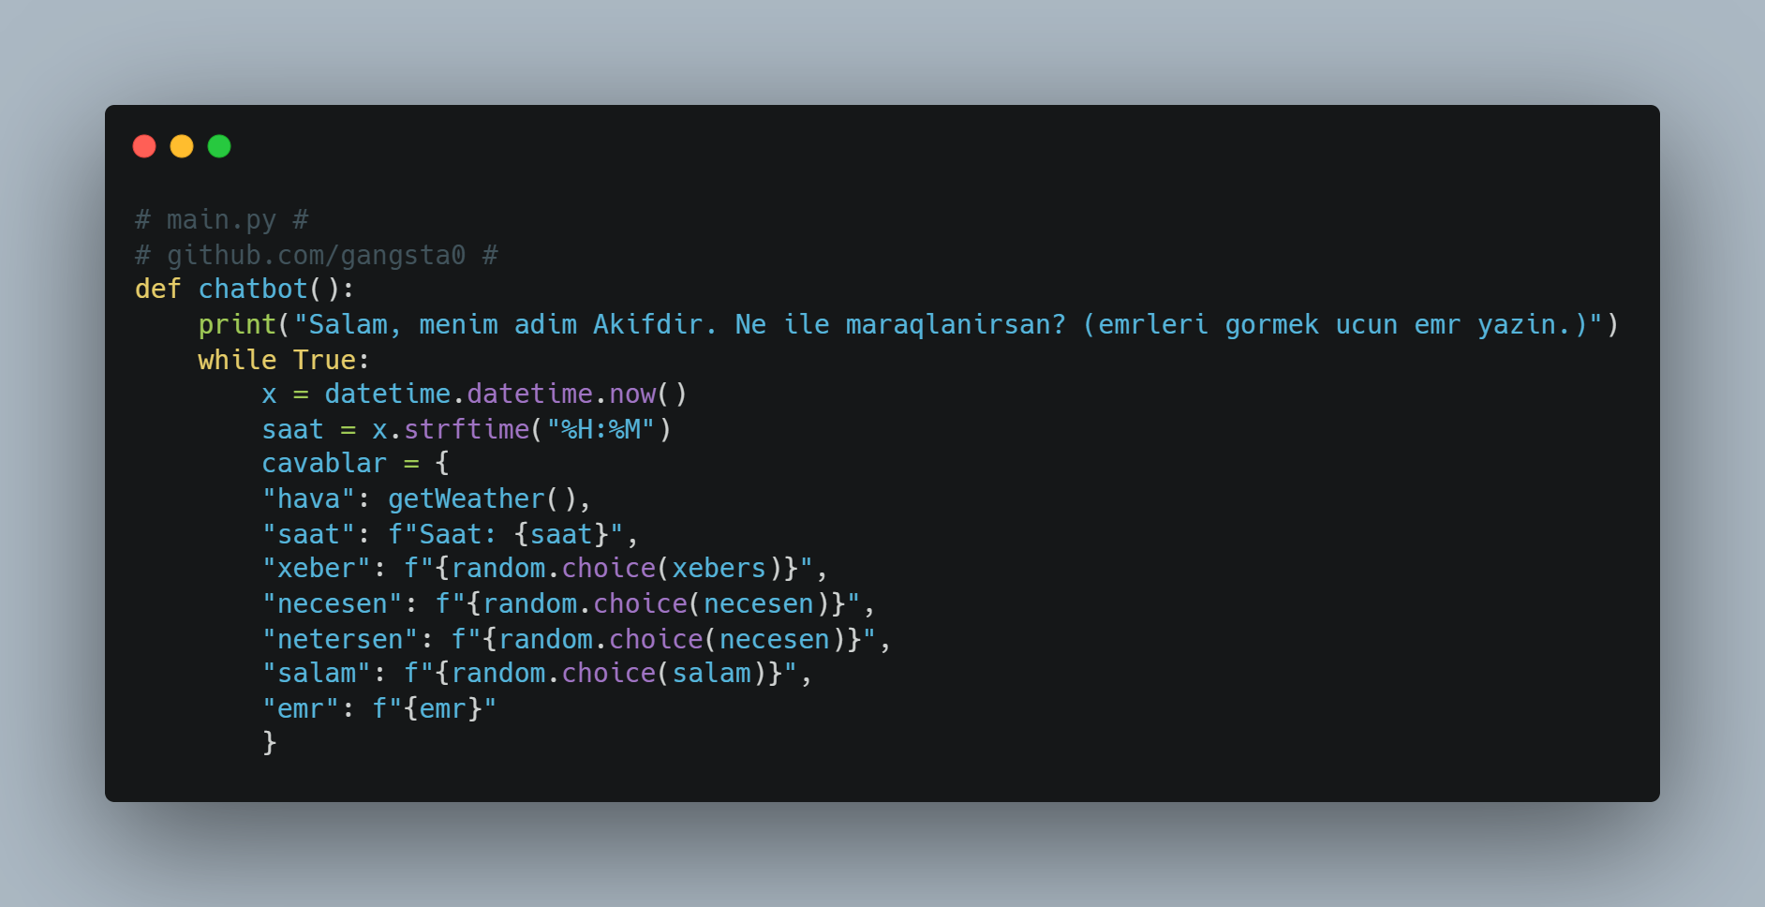
That is the main part of code. When program starts, print message to notice that bot started succesfully. We use while True to run program nonstop. x variable is important for time function. We use datetime module to know time. saat variable is define the time. %H - hour, %M - minute. And there is cavablar dict. We will see its function in messages.py

Slide 8
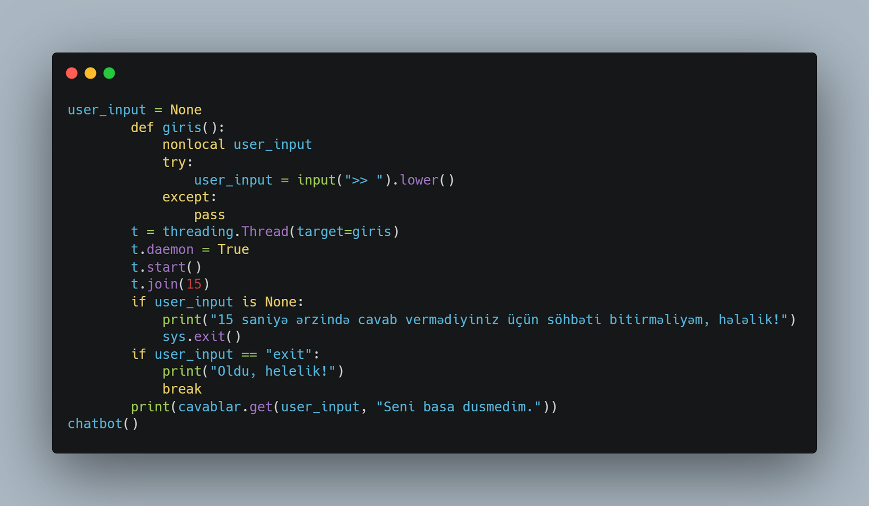

Other part of chatbot()
This part of the code waits for the user to type something. It uses a function called giris() to take the input. The input is read in a different thread, so the main program does not stop. The program waits for 15 seconds. If the user does not write anything in 15 seconds, it shows a message and ends the program. If the user types "exit", it also ends the program. If the user writes something else, the chatbot gives an answer.

Slide 9
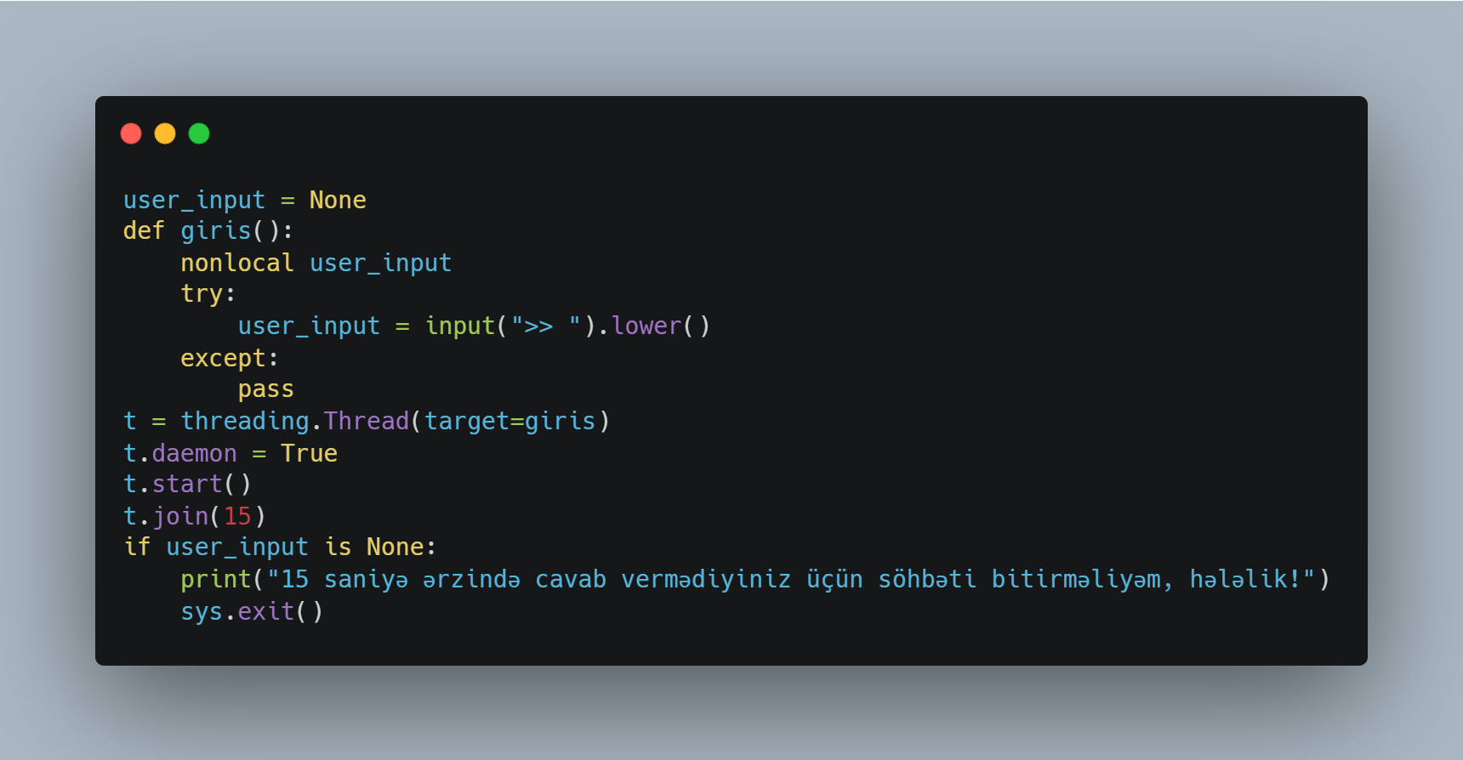
15 seconds explanation
Firstly we define user_input as None. Then we create the function called giris(). This function used to get input from user. And we wrote nonlocal user_input. Now the function giris() can modify the user_input variable. We said that the program will stop if user didn’t write anything for 15 seconds. Threading modul help us to create this function.

Slide 10
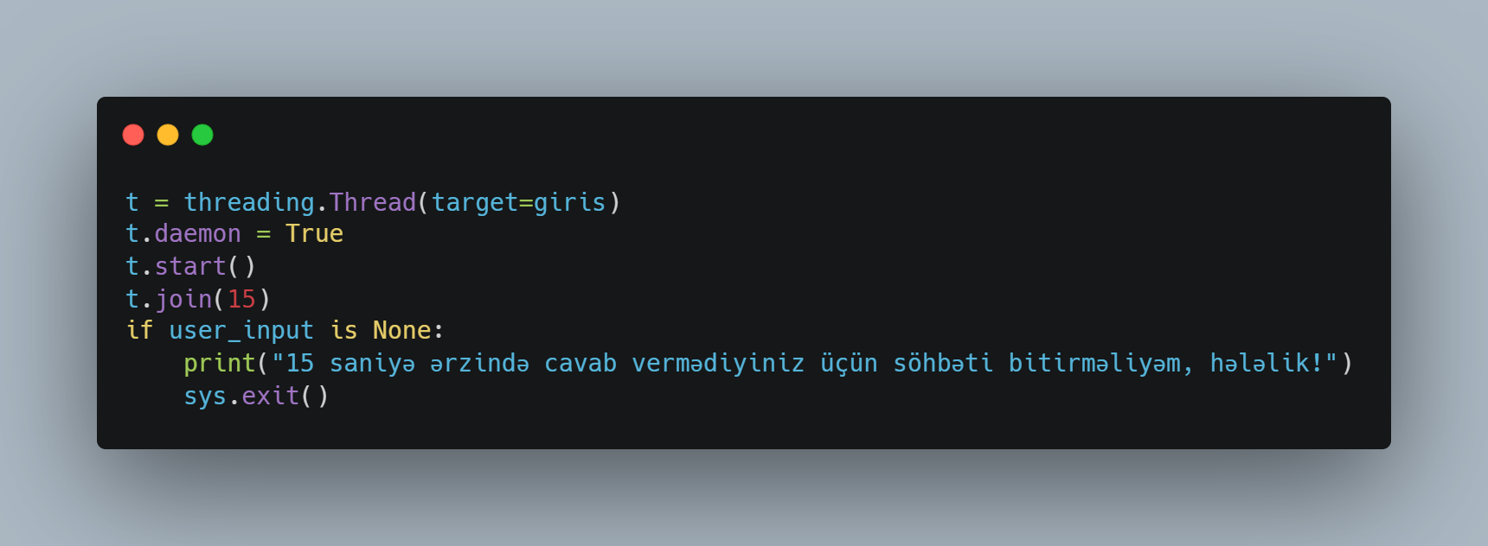
Threading module
threading.Thread(target=giris) - this is the syntax of threading module and target is the name of function giris.
t.daemon = True - Makes the thread a daemon, meaning it will stop when the main program ends.
t.start() - start the thread.
t.join(15) - we set the time.
We set the variable user_input to None. So if user_input still None, that is mean user did not write anything, then program will stop.

Slide 11
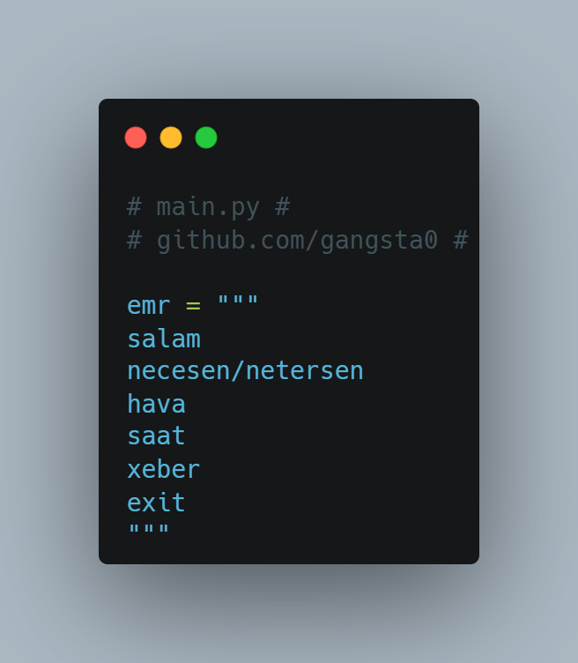
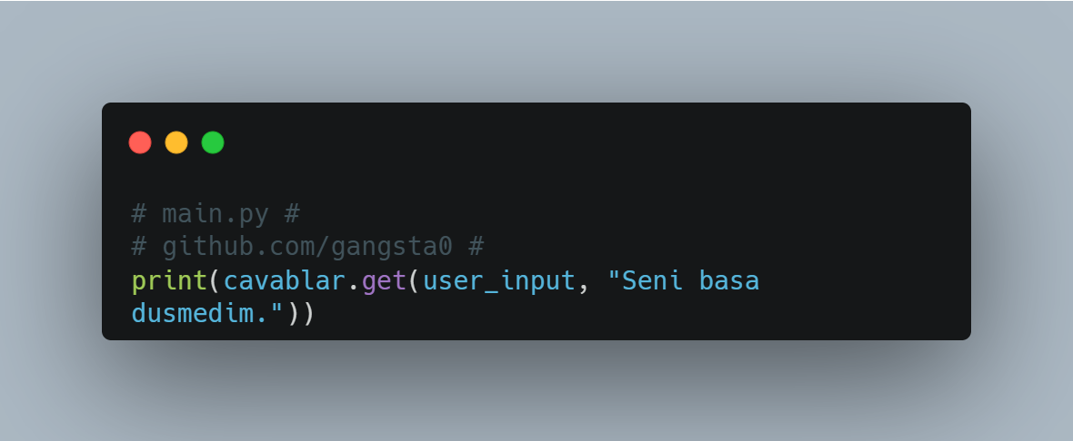
Supported commands
These are the commands bot can understand.
Previous slide there was this code. If user enter anything which is not in emr bot print error message.

Slide 12
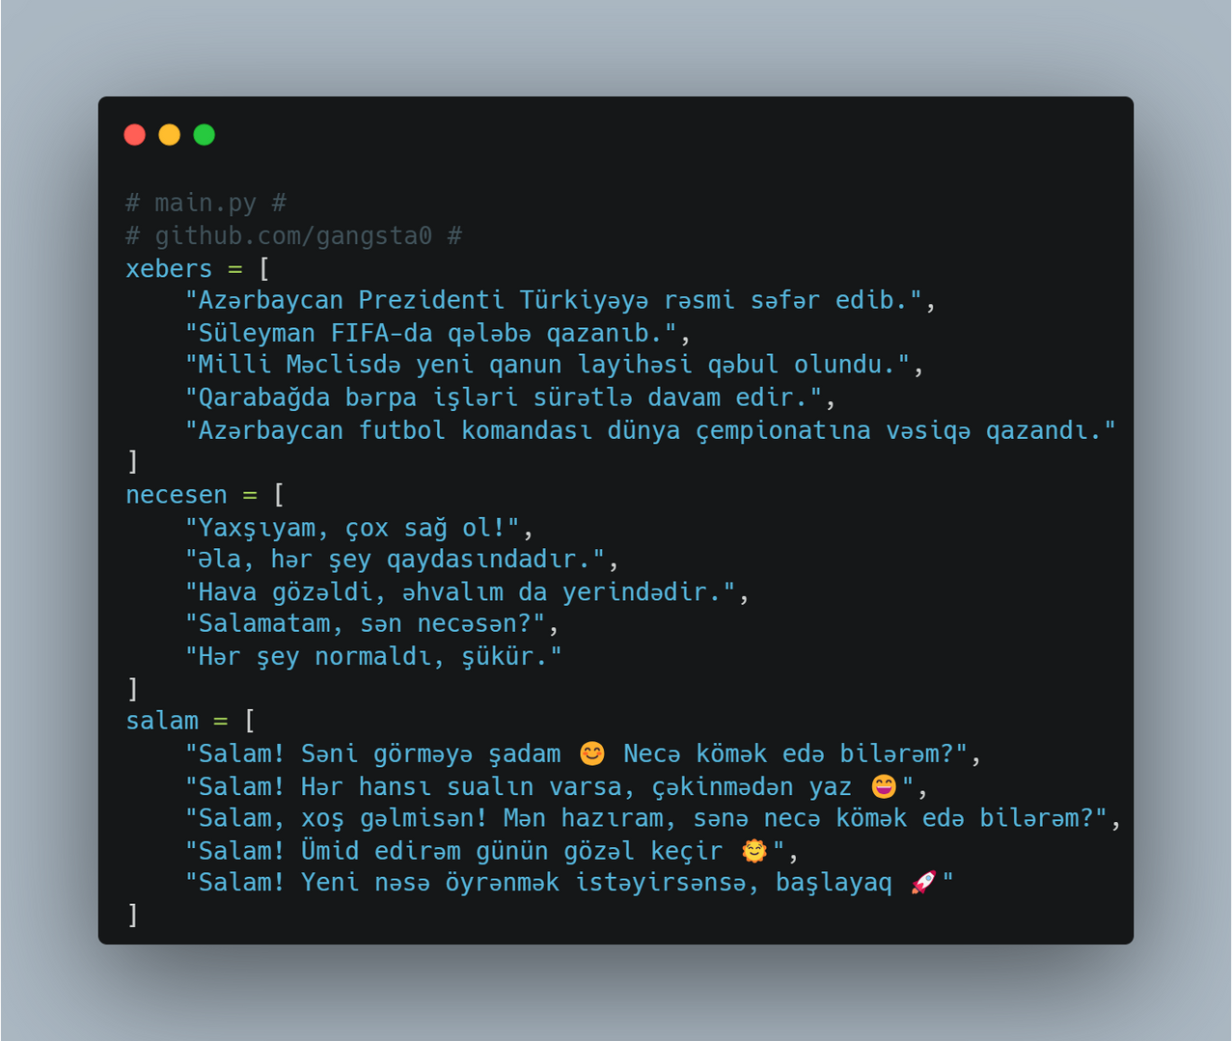
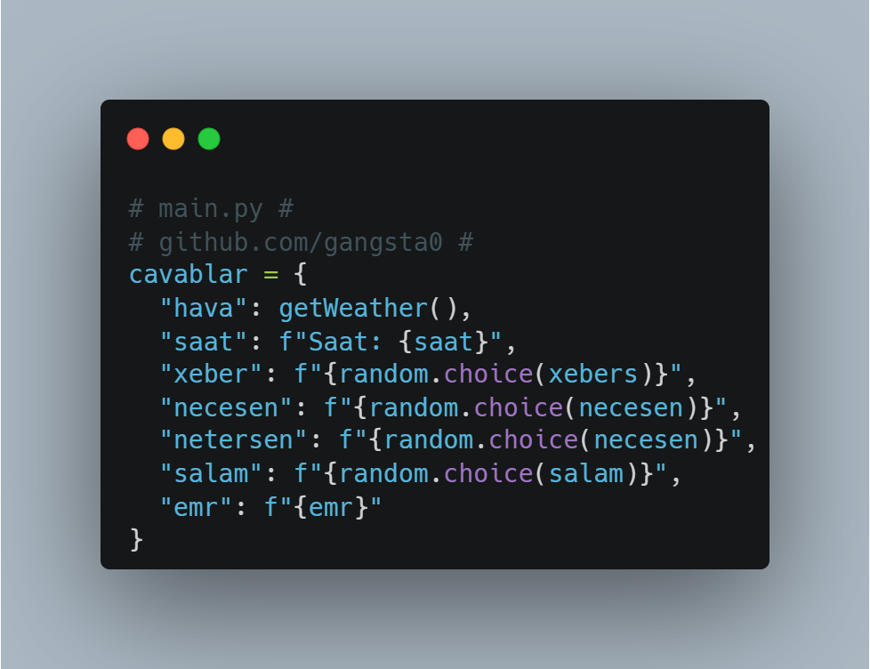
Answers
These are the answer messages. For example, If user enter necesen/netersen bot select answer randomly from necesen list. There is 5 different answers for each command. random module ensures that it is not the same answer every time.

Slide 13

THANKS FOR YOUR ATTENTION

